Slide 1


Faculty of Computing and Informatics
Department of Computer Science
IT Infrastructure Administration and Services
ITA711S
2023 - Semester 1
Event Specific Picture – behind red graphic
Chapter 3
Daemons and Services

Slide 2
Outline
Daemons and Services
Examples of daemons
Services in Windows
Ports

Slide 3
Overview
Program (job)
  Inactive unit. E.g. File stored on a disk
  A unit of work submitted by a user (not a process)
Process (task)
  A program in execution
  Active entity
    Requires resources (e.g. RAM, CPU, etc.) to perform function.
Process management
  - keeping track of processes and the states they are in.
Thread
  Portion of a process
  Runs independently

Slide 4
Daemons and Services
Daemons are background processes that are running without user interaction.
Although any process running in the background can be called a daemon, in Linux a daemon is a system process running in the background.
Windows-> Services
Unix/Linux-> Daemons (Parent daemon init PID 1)
Usually started on boot-up to run in background, or responds to network request or hardware activity by performing a specified task.
Carry out essential services for users or on the server/unit itself.

Slide 5
Daemons and Services
Daemons can be used to configure hardware or schedule tasks.
Common daemon processes include print spoolers, email handlers, web services and other programs that manage administrative tasks.
E.g. the printer services are provided by printer daemon, lpd. The e-mail services is provided by smtpd daemon, and the web-browsing service is handled by the httpd daemon.
Systems Administrators has the task of organizing and configuring network services by setting up daemons.

Slide 6
Examples of daemons
Daemons respond to alerts from the OS upon some external event, such as the arrival of a message on the network.
For messages coming from the network, the TCP/IP module on the host computer looks up the port number of the message and sends an alert to the daemon assigned to that port number.
For example, port number 80 is assigned to HTTP, so when a message with that port number is received, the TCP/IP stack built into the OS sends a signal to the HTTPd.

Slide 7
init daemon
init is the first process to run after the system boots, and in many ways it is the most important daemon.
At startup, init either places the system in single-user mode or begins to execute the scripts needed to bring the system to multiuser mode.
In multiuser mode, init is responsible for making sure that processes are available to handle logins on every login-enabled device.
init also has the responsibility to remove undead zombie processes that would otherwise accumulate on the system.
init defines the runlevels that determine what set of system resources should be enabled. There are seven runlevels, numbered 0 to 6.
xinetd and inetd daemons manage other daemons.

Slide 8
Runlevels
Runlevel | Description
0 | Used to halt the system. This runlevel is reserved and cannot be changed.
1 | Used to run in a single-user mode. This runlevel is reserved and cannot be changed.
2 | Not used by default. You are free to define it yourself.
3 | Used to run in a full multi-user mode with a command-line user interface.
4 | Not used by default. You are free to define it yourself.
5 | Used to run in a full multi-user mode with a graphical user interface.
6 | Used to reboot the system. This runlevel is reserved and cannot be changed.

Slide 9
Services in Windows
  To check and control services (daemons) on Windows XP/7/8/10/Server
    Start->run->services.msc or
    Start->programs->administrative tools-> services

Slide 10
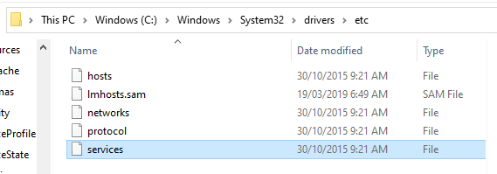
Services in Windows
  To check and control services (daemons) on Windows XP/7/8/10/Server

Slide 11
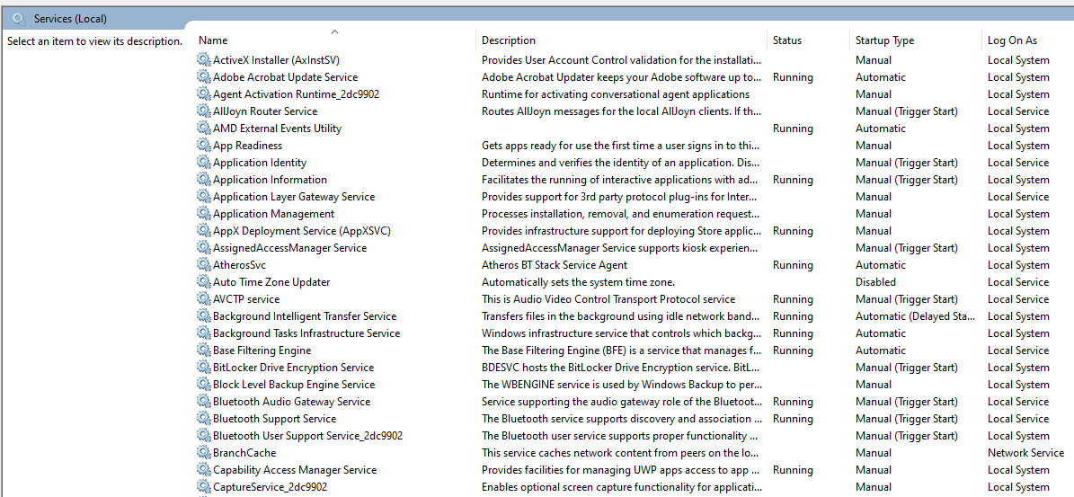
Services in Windows

Slide 12
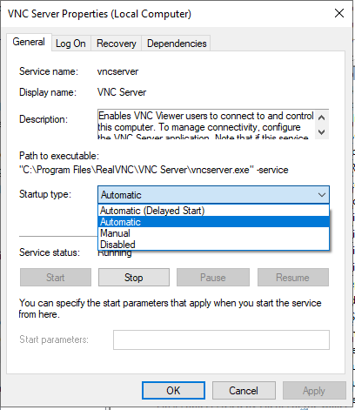
Services in Windows

Slide 13
Daemons in Linux
  To check and configure daemons in Linux
    Enter terminal window, type vim /etc/services to view ports, or to configure modify /etc/inetd.conf

Slide 14
Specific Ports
  Port numbers are not so controlled.
  Certain ports have become standard for certain services
    ftp (20&21), telnet (23), DNS (53)
  Port numbers are 16-bit unsigned numbers, 0 - 65535
  Port scanning involves the sending of a carefully constructed packet to each port, to check which ones are open.
  Normally services listening on ports usually log a scan, therefore logs can be reviewed on a certain port, however hackers use stealth scan techniques to avoid this.

Slide 15
Port ranges
0 to 1023
well known
49152 to 65535 private/dynamic
1024 to 49151
registered
Managed by Internet Assigned Numbers Authority (IANA)
The well known range is protected and should not be used without IANA registration.
For services that are not registered, they make use of the private/dynamic range
Systems administrators evaluate the ports that are already in use by the system and applications.
A firewall can be configured to avoid conflicts of assigning ports that are already used.
A list of currently used TCP- and UDP -ports can be created with the command netstat -a

Slide 16
Ports
  Homework
  Which software/tools can be used to identify status of ports?
  Port status can either be: closed, open or filtered. What is meant by each status?
  Which services listens on port:
  20; 21; 22; 23; 25; 53; 67; 68; 69; 80; 110; 137-139; 143; 161; 443; 465; 993; 995

Slide 17

End

